Slide 1
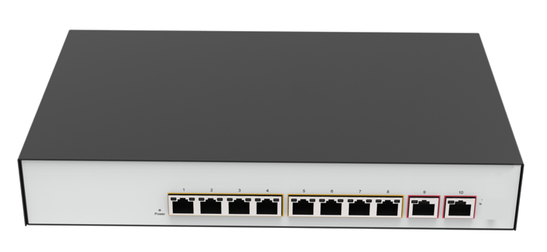
Datasheet|8 GE+2 GE Smart PoE Ethernet Switch
FR-S2810G-110P2
Description
FR-S2810G-110P2 is a high-performance chip solution all-Gigabit smart Ethernet switch product, which provides 10 10/100/1000Mbps adaptive RJ45 ports , and supports wire-speed forwarding of all ports, providing you with greater network flexibility. Network port VLAN configuration, static MAC address binding, port isolation, loop detection, device restart and other operations can be carried out through Web. It can be connected to customer cloud and support cloud management to provide a more efficient, simple, secure and easy-to-use remote management mode.
The FR-S2810G-110P2 has 8 RJ45 ports with PoE function,supports the IEEE802.3at standard, and is backward compatible with 802.3af. It can be used as a power-over-Ethernet device. It can automatically detect and identify power-receiving devices that comply with the standard, and power it through a network cable.The product has a highly integrated design, simple operation, and multiple modes to choose from, which is suitable for various applications, especially for security monitoring occasions.
Features
Comply with IEEE 802.3i、IEEE 802.3u、IEEE 802.3ab、IEEE 802.3x、IEEE 802.3at、IEEE 802.3af
The lightning protection capability of the port reaches 6kV, and the product has been used stably for 3 years
Support for management port rate, duplex, self-negotiation, port mode
Support for loop protection
Support for port-based VLAN
The maximum output power of a single port is 30W, and the total output power of PoE is 110W
Support remote restart of PoE ports
Dynamic LED indicator, providing simple working status prompts and troubleshooting
Built-in power supply, delicate structure design, suitable for use
湖南恒茂高科股份有限公司
HUNAN FULLRIVER HIGH TECHNOLOGY CO.,LTD.
Notes:
V 1.00 initial version

Slide 2
Specification
Model |  | FR-S2810G-110P2
Chipset |  | EN8851C+2*EN8801S+IP808AR
Standards |  | IEEE 802.3i、IEEE 802.3u、IEEE 802.3ab、IEEE 802.3x、IEEE802.3at、IEE802.3af
Ports |  | 10*10/100/1000Mbps Auto-Negotiation ports（Auto MDI/MDIX）
Network Media(Cable) |  | 10BASE-T: UTP category 3, 4, 5 cable (maximum 100m) 100BASE-TX/1000BASE-T: UTP category 5, 5e or above cable (maximum 100m)
Transfer Method |  | Store-and-Forward
MAC Address Table |  | 8K
Switching Capacity |  | 20Gbps
Packet Forwarding Rate |  | 14.88Mpps
Packet Buffer |  | 4Mbits
Jumbo Frame |  | 15KB
LED indicators | Per Device | Power：Green
 | Per-Port | Link/Act/Combo：1000M：Green 100M：Orange
 |  | PoE：Orange
PoE Power Supply |  | Ports 1 to 8 support IEEE 802.3af/at standard PoE power supply1 2 +, and 3 6 -
Power Supply |  | 100-240V,50/60Hz,53.5V 2.8A
PoE Power Consumption |  | Maximum：110W
Dimensions（L×W×H） |  | 280*180*44mm
Environment |  | Operating Temperature: 0℃ ~ 45℃ Storage Temperature: -40℃ ~70℃ Operating Humidity: 10%~90% non-condensing Storage humidity: 5%~90% non-condensing
湖南恒茂高科股份有限公司
HUNAN FULLRIVER HIGH TECHNOLOGY CO.,LTD.

Slide 3
Software
Mac | Support static configuration and dynamic learning of MAC addresses Support viewing and clearing of MAC addresses
VLAN | Support 802.1Q Support the setting of port VLAN types
Port Configuration | Support the configuration of port rate, description, duplex mode, flow control, etc Support real-time utilization rate statistics Support port byte count statistics Support port mirroring Support static aggregation of ports
Multicast | Support IGMP v1/v2
QoS | Support configuring ingress and egress rates of ports Support 802.1p/DSCP Support storm control
Reliability | Support loopback-detection
PoE | Support remote restart of PoE ports Support PoE extend Support PoE watch dog
Security features | Support port isolation
Management and maintenance | Support modifying device information Support user management Support management via browser-based WEB mode Support system logs Support configuration import and export Support HTTP
湖南恒茂高科股份有限公司
HUNAN FULLRIVER HIGH TECHNOLOGY CO.,LTD.

